Slide 1

Chapter 6: Parallel dc Circuits

Slide 2
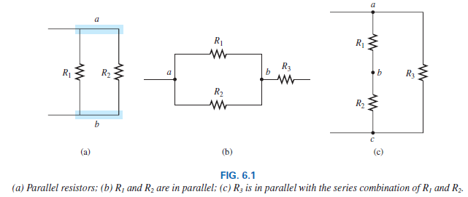
6.2 Parallel Resistors
Two elements, branches or networks are in parallel if they have two points in common.

Slide 3
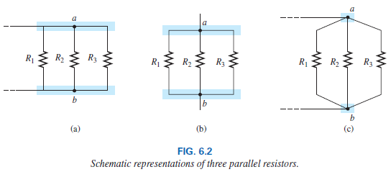
6.2 Parallel Resistors
On schematics, the parallel combination can appear in a number of ways, as shown in Fig. 6.2. The three resistors are in parallel. They all have points a and b in common.

Slide 4

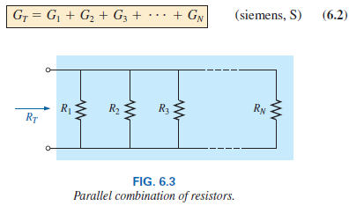
6.2 Total Resistance and Conductance
For resistors in parallel as shown in Fig. 6.3, the total resistance is determined from the following equation:
Since G = 1/R, the equation can also be written in terms of conductance levels as follows:
The equation of total conductance is an exact match in format with the equation for the total resistance of resistors in series: R_{T} = R₁ + R₂ + R₃ + . . . + R_{N}.
This duality results in when you are able to write one equation to the other simply by interchanging R and G.

Slide 5

6.2 Total Resistance and Conductance
In general, however, when the total resistance is desired, the following format is applied:

Slide 6
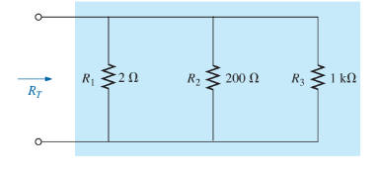
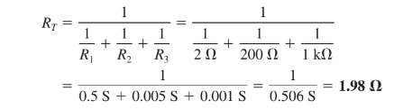
Example 6.1

Slide 7
6.2 Examples
In general, the total resistance of parallel resistors is always less than the value of the smallest resistor. This is particularly important when you want a quick estimate of the total resistance of a parallel combination.
In addition, if the smallest resistor of a parallel combination is much smaller than the other parallel resistors, the total resistance will be very close to the smallest resistor value (Example 6.2).
The total resistance of parallel resistors will always drop as new resistors are added in parallel, irrespective of their value.
Recall that this is the opposite of series resistors, where additional resistors of any value increase the total resistance.

Slide 8
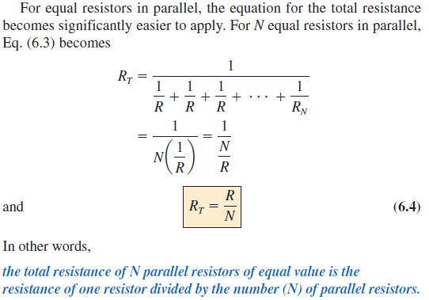
6.2 Equal Resistors in Parallel
Example 6.5

Slide 9
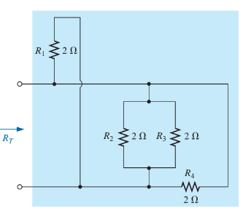
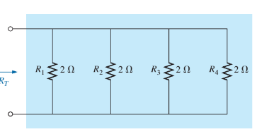
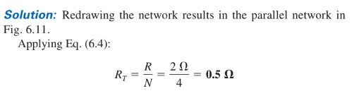

Slide 10
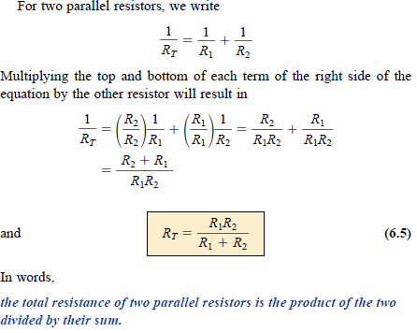
6.2 Special Case: Two Parallel Resistors
Example 6.7
Example 6.8

Slide 11
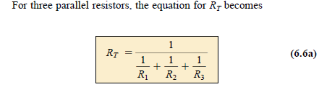
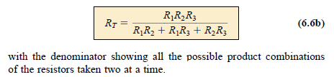
6.2 Special Case: Three Parallel Resistors

Slide 12

6.2 Interchanging Parallel Resistors
Example 6.9

Slide 13

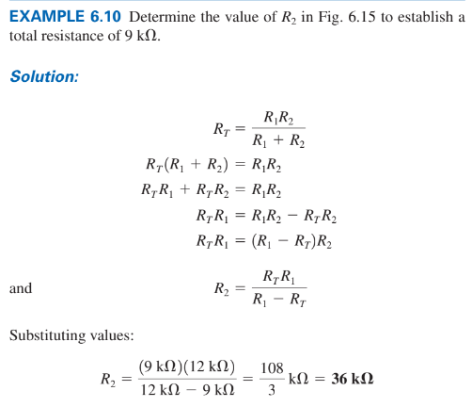
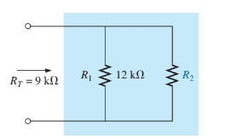
Example 6.11

Slide 14
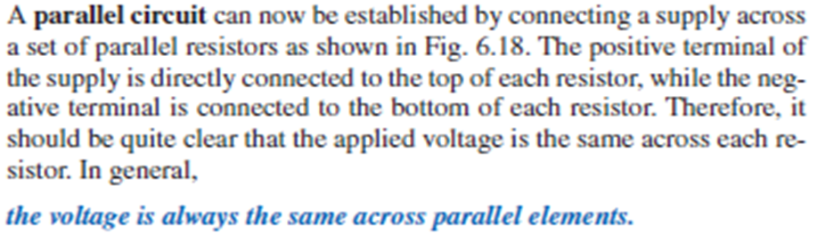

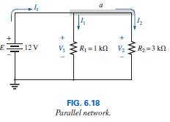
6.3 Parallel Circuits

Slide 15

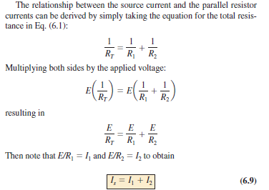
6.3 Parallel Circuits

Slide 16
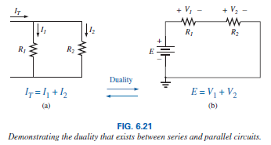
6.3 Parallel Circuits
The result reveals a very important property of parallel circuits: For single-source parallel networks, the source current (I_{s}) is always equal to the sum of the individual branch currents.
Again, for a parallel circuit, the source current equals the sum of the branch currents, while for a series circuit, the applied voltage equals the sum of the voltage drops.
In general, for parallel resistors, the greatest current will exist in the branch with the least resistance.
A more powerful statement is that the current always seeks the path of least resistance.

Slide 17
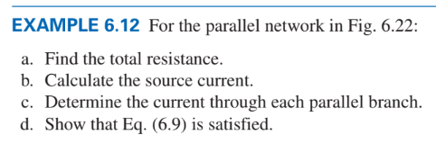
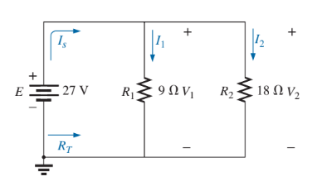
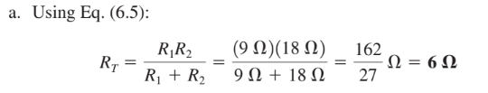
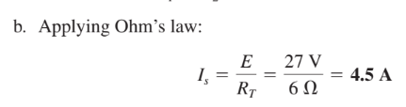
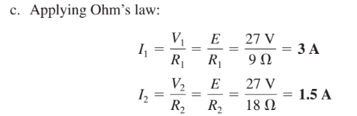


Slide 18
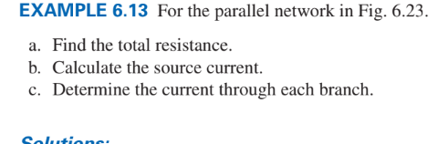
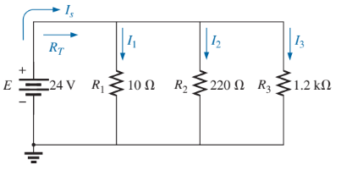
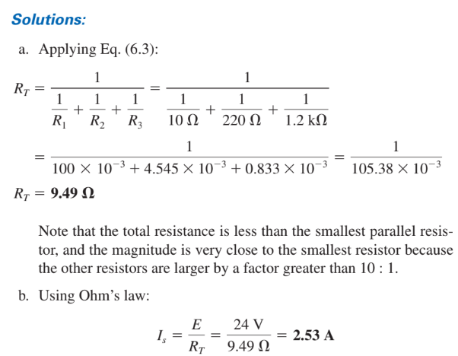

Slide 19
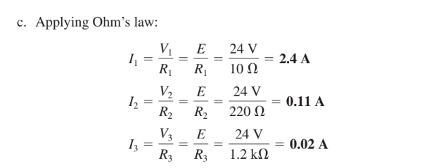

Slide 20
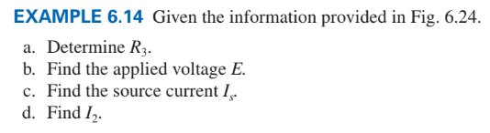
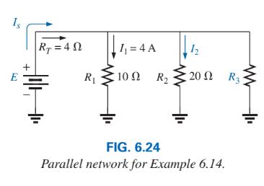
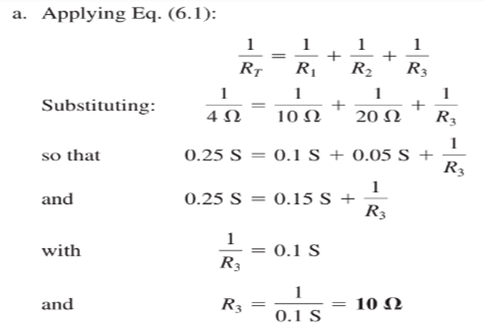


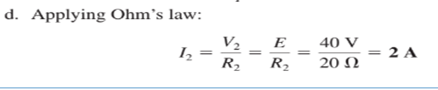

Slide 21
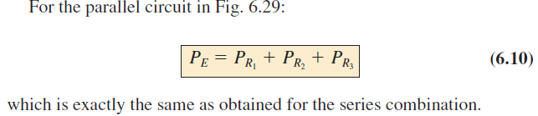
6.4 Power Distribution in a Parallel Circuit
Recall from the discussion of series circuits that the power applied to a series resistive circuit equals the power dissipated by the resistive elements.
The same is true for parallel resistive networks. In fact, for any network composed of resistive elements, the power applied by the battery will equal that dissipated by the resistive elements.

Slide 22
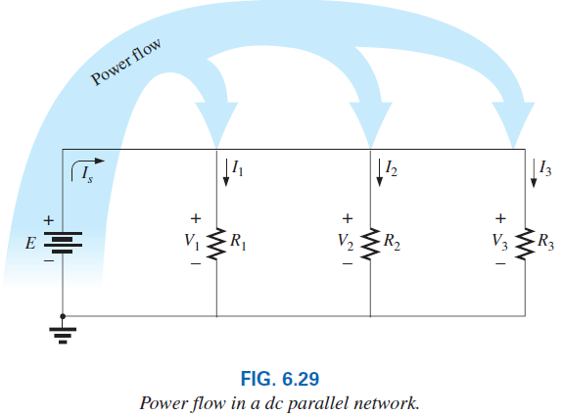
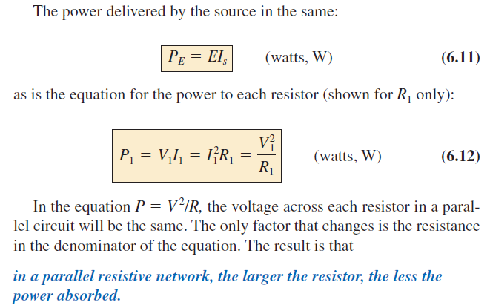
6.4 Power Distribution in a Parallel Circuit

Slide 23
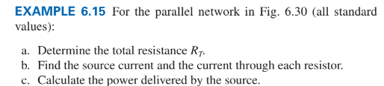

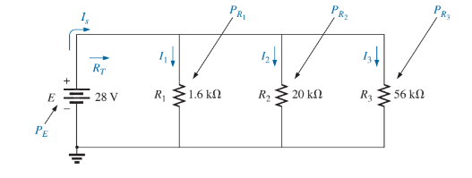
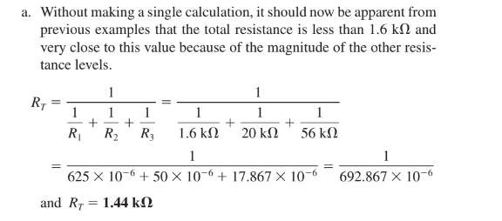

Slide 24
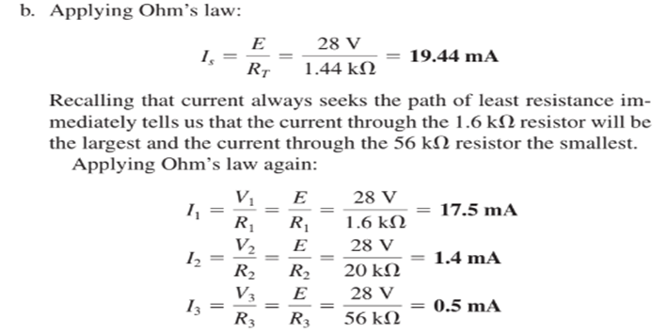

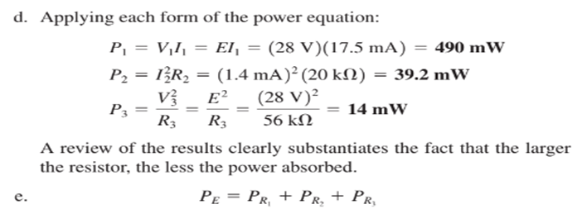


Slide 25
6.5 Kirchhoff’s Current Law
Kirchhoff’s voltage law provides an important relationship among voltage levels around any closed loop of a network.
Professor Gustav Kirchhoff is also credited with developing the following equally important relationship between the currents of a network, called Kirchhoff’s current law (KCL):
KCL states that the algebraic sum of the currents entering and leaving a junction (or region) of a network is zero.
In other words, The sum of the currents entering a junction (or region) of a network must equal the sum of the currents leaving the same junction (or region).

Slide 26

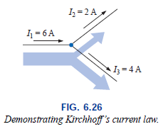
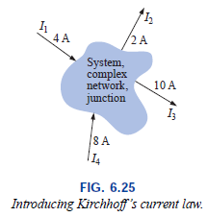


6.5 Kirchhoff’s Current Law

Slide 27
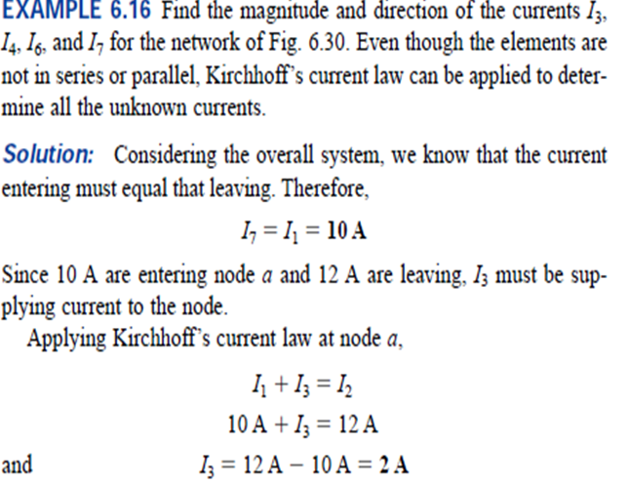
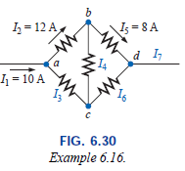
6.5 Kirchhoff’s Current Law

Slide 28

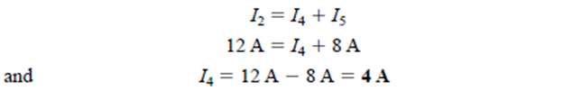
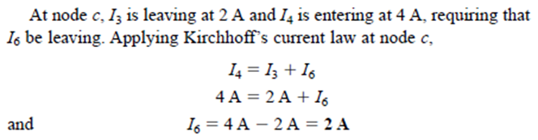
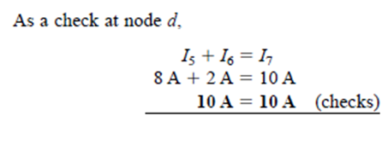
6.5 Kirchhoff’s Current Law

Slide 29
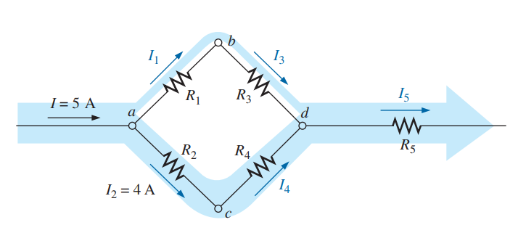
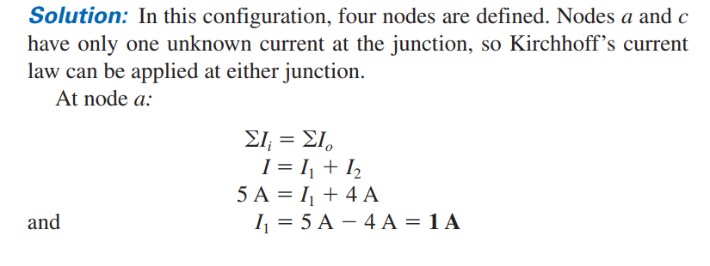

Slide 30
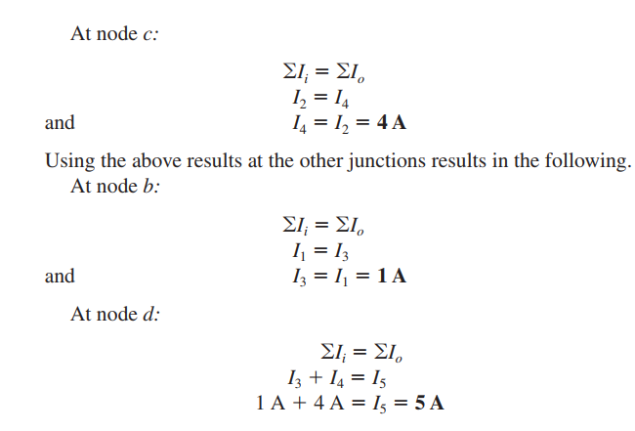

Slide 31

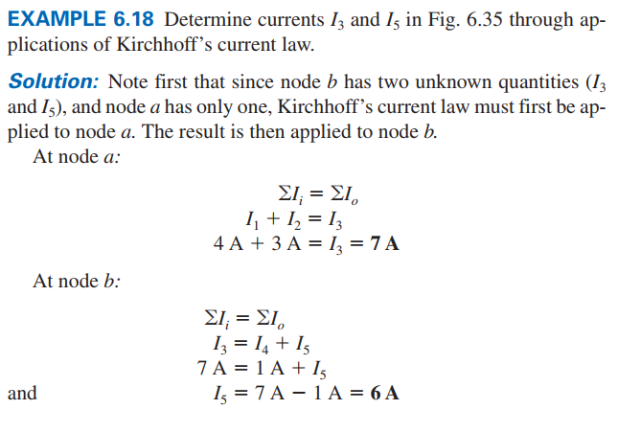


Slide 32




Slide 33


Slide 34
6.5 Kirchhoff’s Current Law: Examples
On many occasions, the direction of the unknown current is not provided. With so many currents entering or leaving the system, it is difficult to know by inspection which direction should be assigned to unknown current.
In such cases, simply make an assumption about the direction and then check out the result. If the result is negative, the wrong direction was assumed. If the result is positive, the correct direction was assumed. In either case, the magnitude of the current will be correct.

Slide 35
Thank You

